Slide 1
Shooters Club
Julian Lucas

Slide 2
App Idea
Live Multiplayer Shooting Game
Implementing Location Services
Allows for fast play
Instant action
Arena Size
Size of Campus
Utilizes a map kind of like Snap map

Slide 3
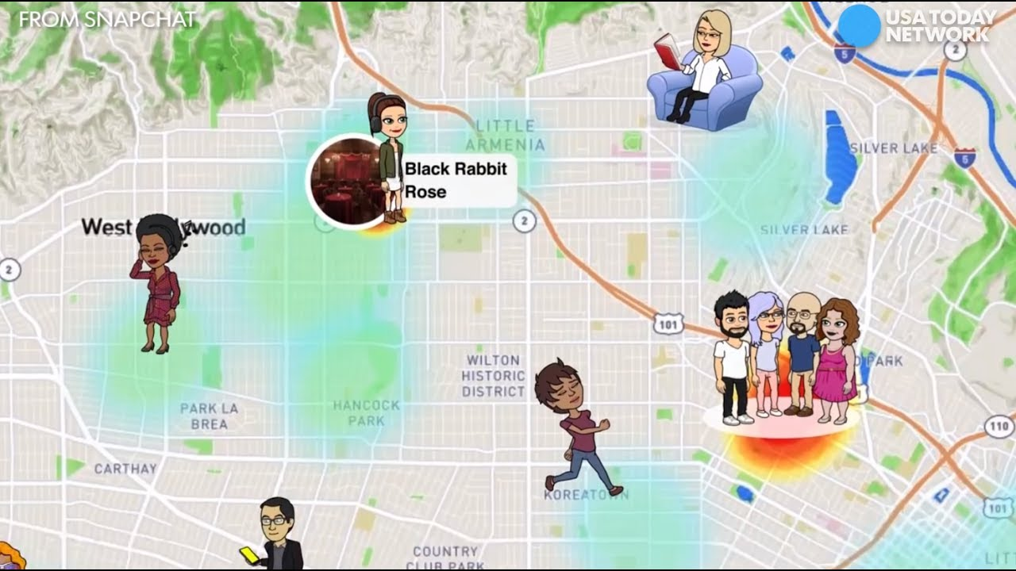
Location Of Players

Slide 4
Different Guns
Pistol
For shooting multiple shots, in medium to short encounters, normal reload, -15hp
Shotgun
Close Encounters, medium-slow reload ,-30hp
Sniper
Long distance, slow reload , -25hp, headshot -50hp

Slide 5
Big Battles! Having Teams?
Multiple teams kind of like Pokemon Go
Join a Color/Team
Get the most kills
Receive extra life after each week
Battles Idea?
Battles at certain time of day
Extra Damage by sniper
Notes:
5 minute wait time after each death

Slide 6
Daily Hint!
It may be hard to find your target in a group of people
How about a daily hint?
Live picture of a piece of clothing
Noticeable!

Slide 7
Motivation
A game you can pickup and play anywhere
Play with friends or Random people
To create something new that isn’t on the app store with the possibility to build on it

Slide 8
Phone requirements
Camera
Location Services
Data/Wifi

